Slide 1
Cybersecurity Intrusion Detection
Joanna Fedjo Tsague
Joanna Fedjo Tsague
By Cyber Data Explorers
Sumedha DasGupta
Srujana Sirimala
Vaishnavi Yadav
Joanna Fedjo Tsague

Slide 2

Introduction
This project focuses on building a smarter intrusion detection system by analyzing both network traffic and user behavior.
Unlike traditional rule-based methods, which attackers can bypass, this approach uses machine learning on a rich dataset to identify abnormal patterns.
The aim is to enhance cybersecurity by detecting intrusions accurately while minimizing false alarms

Slide 3




Problem to be solved
Cyberattacks are evolving, bypassing traditional rule-based tools.
False Positives: Too many alerts exhaust analysts.
Missed Threats: Subtle attacks slip through undetected, causing major damage.
Smart Solution Needed: Adaptive, data-driven IDS that ensures accuracy and trust.

Slide 4



GOALS
Early Detection
Smart Learning
Balanced Defense
Future Ready
Identify suspicious activity (failed logins, odd hours, abnormal packets)
Use machine learning instead of rigid rules
High accuracy with fewer false positives
Build adaptive IDS that evolves with new threats

Slide 5
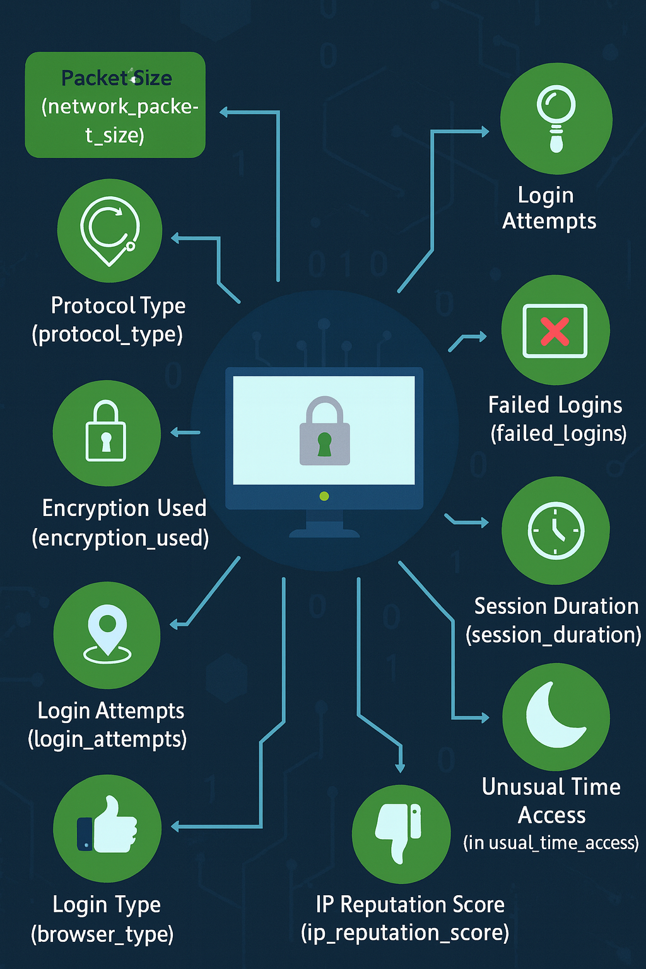
Data Description
The dataset is carefully structured to capture both technical signals from network traffic and behavioral patterns from users. The target variable- is attack detected or not.

Slide 6
Data Cleaning
Cleaned categorical columns
Rounded off values of session duration to 2 decimal places
Dropped null values (3% of total data)
Dropped session_id column
Converted categorical datatypes to numeric using one-hot encoding
Notes:
Before building our machine learning model, I first focused on preparing and cleaning the dataset.
Step one was cleaning the categorical columns. This included fixing typos, standardizing formats, and making sure categories were consistent.
Step two was rounding off the session duration values to two decimal places to keep the data precise but consistent.
Next, I dropped the null values, which only accounted for about 3% of the data, so this didn’t affect the overall dataset much.
I also removed the session_id column, since it was just an identifier and had no predictive value.
Finally, I converted all categorical variables into numeric form using one-hot encoding, which makes them suitable for machine learning algorithms.
By applying these steps, I ensured the dataset was clean, consistent, and ready for model training.”

Slide 7

Data Description
Dataset Overview (9,253 records)
network_packet_size: avg ~506 bytes, ranges 64 – 1285
login_attempts: avg ~4, min 1, max 13
session_duration: avg ~793 sec, but very wide range (0.5 – 7190)
ip_reputation_score: highly skewed, mean ~10 but max ~999
failed_logins: avg ~1.5, max 5
unusual_time_access: mostly 0 (15% are unusual times)
attack_detected: ~45% of sessions labeled as attack
Notes:
This dataset has 9,253 records, with features like packet size, login attempts, and session duration. Most users average 4 login attempts and 1–2 failed logins, but there are outliers in session duration and IP reputation score. About 45% of sessions are labeled as attacks, giving us a balanced dataset for classification.

Slide 8
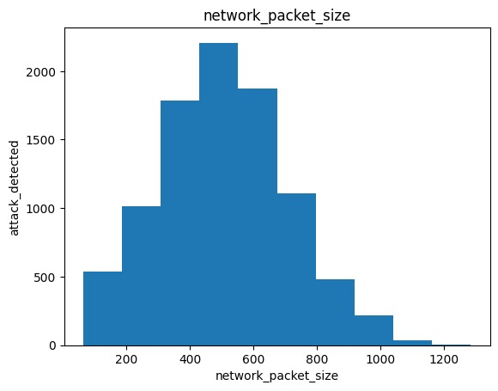
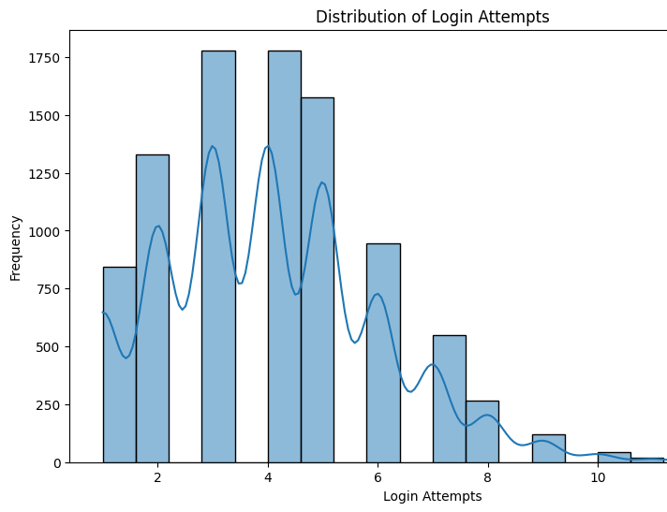
Visualizations
most attacks are associated with medium-sized network packets (around 400–600 bytes)
most users make 3–5 login attempts.
Notes:
This histogram shows that most attacks are associated with medium-sized network packets (around 400–600 bytes), while very small or very large packets are less frequent.
This graph shows that most users make 3–5 login attempts, while very high numbers of attempts are rare but could indicate suspicious activity.

Slide 9

Logistic Regression
Accuracy: ~72% (training & testing sets)
Precision: 71% of predicted attacks were correct
Recall: 63% of actual attacks were identified
F1-score: Balanced precision & recall (~0.72–0.76)
This Photo by Unknown Author is licensed under CC BY-NC
Notes:
Next, I used this clean data to train Logistic Regression model. Here we can see the performance of the logistic regression model. The overall accuracy is about 72% on both training and test sets. Precision for detecting attacks is 71%, which means that when the model predicts an attack, it’s correct about 7 out of 10 times. Recall is 63%, meaning the model identifies about two-thirds of actual attacks.

Slide 10

Logistic Regression (Cont’d)
Confusion Matrix (Test Set)
Correct predictions: 804 (no attack), 539 (attack)
Misclassifications: 195 (missed attacks), 313 (false alarms)
Key Insights
Model shows moderate performance, with balanced precision & recall.
Higher failed login attempts strongly increase likelihood of attack.
Some unexpected findings (e.g., unusual time access negatively associated with attacks) require further analysis.
Convergence warning: Model may improve with more iterations or scaling.
Notes:
The confusion matrix shows the tradeoff: while it detects many attacks, it also misses some and raises false alarms. One interesting insight from the coefficients is that failed logins are a strong signal of attacks, while unusual time access surprisingly shows a negative association — this could be noise or an area for deeper investigation.
Finally, the convergence warning suggests the model didn’t fully optimize, so scaling features or increasing iterations may improve results.

Slide 11
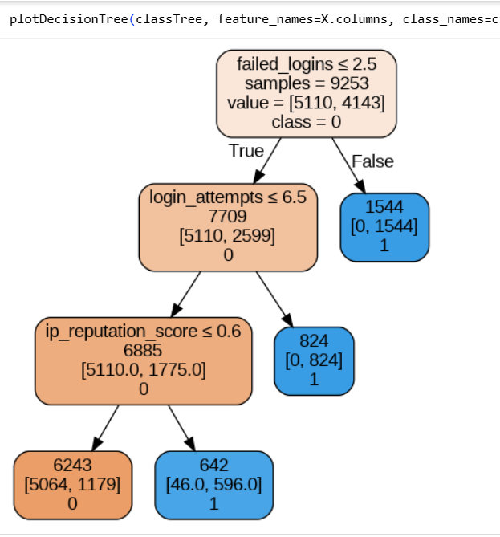
Decision Tree
Why we used it:
Easy to interpret and explain to non-technical stakeholders.
Well-suited for categorical outcomes (e.g., attack detected vs. no attack).
Managers can see the logic of the model: transparent “if-then” rules.
Highlights the key drivers of cyberattacks (which variables matter most).
Provides a clear foundation for making security decisions.
Notes:
“The Decision Tree model gave us an overall accuracy of about 86%, which is strong.”
“It performs very well at identifying safe cases (True Negatives), meaning it won’t overwhelm us with false alarms.”
“But the cost is high false negatives—249 actual attacks were missed. In cybersecurity, this can be critical.”
“So while this model is accurate, managers must weigh the trade-off between minimizing false alarms and ensuring actual threats aren’t missed.”

Slide 12
Decision Tree
Accuracy: 85.95% (model correctly classified ~86% of cases)
True Positives (603): Correctly detected attacks
True Negatives (988): Strong ability to detect when there is no attack
False Positives (11): Very few false alarms (Type I error)
False Negatives (249): Missed attacks (Type II error)
Precision: ~98.2%
Recall: ~70.8%
 | Prediction
Actual | 0 | 1
0 | 988 | 11
1 | 249 | 603
Recommendation: Use Decision Tree as a first-line filter but should be paired with a more sensitive model or monitoring system for better results.
Notes:
“The Decision Tree model gave us an overall accuracy of about 86%, which is strong.”
“It performs very well at identifying safe cases (True Negatives), meaning it won’t overwhelm us with false alarms.”
“But the cost is high false negatives—249 actual attacks were missed. In cybersecurity, this can be critical.”
“So while this model is accurate, managers must weigh the trade-off between minimizing false alarms and ensuring actual threats aren’t missed.”

Slide 13
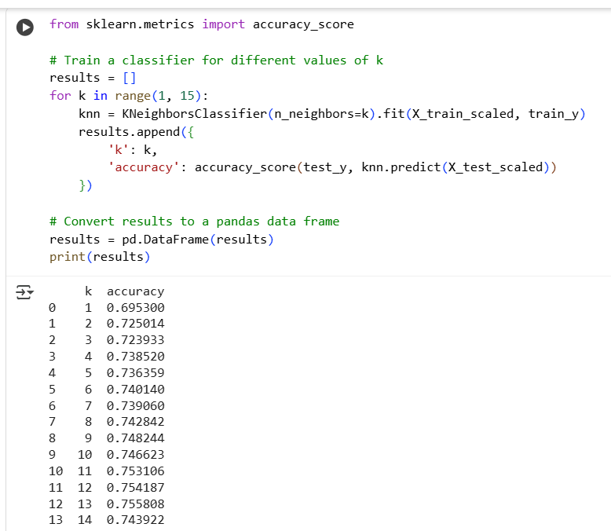
KNN
Why we used it:
Simple, non-parametric model that doesn’t assume underlying data patterns.
Useful for testing pattern recognition in complex datasets.
KNN looks for “similar past cases” to classify new observations.
Performs better when features are scaled properly.
Can adapt well to high-dimensional data, though at higher computational cost.

Slide 14
KNN
Accuracy: ~75.6%
True Positives (correctly predicted attacks): 479
True Negatives (correctly predicted non-attacks): 920
False Positives (incorrectly predicted attacks): 79
False Negatives (incorrectly predicted non-attacks): 373
Precision: ~85.9%
Recall: ~56.2%
 | Prediction
Actual | 0 | 1
0 | 920 | 79
1 | 373 | 479
Recommendation: Not ideal for deployment, but useful as a baseline check.

Slide 15
Performance Comparison
Model | Accuracy | Strengths | Weaknesses
Logistic Regression | 72% | Simple, interpretable, fast to train | Poor accuracy, misses complex intrusion patterns
KNN | 75.6% | Good at reducing false alarms, performs better than logistic regression | Lower detection rate, computationally expensive on large data
Decision Tree | 86% | Highest accuracy, captures nonlinear patterns, easy to interpret | Can be overfit without tuning
Key Takeaways:
Decision Tree outperforms other models with ~86% accuracy, making it the best choice.
Logistic Regression is interpretable but too simplistic for intrusion detection tasks.
KNN improves accuracy compared to logistic regression but suffers from lower detection and higher computation cost.
For cybersecurity monitoring, a model must balance accuracy with detection ability → Decision Tree provides this balance.

Slide 16
Managerial Insights
Actionable Recommendations:
Deploy Decision Tree in IDS: Integrate the model with existing monitoring tools to flag suspicious sessions.
Model Maintenance: Retrain periodically with new network traffic data to adapt to evolving attack patterns.
Overfitting Control: Use pruning, depth control, or cross-validation to ensure robust performance.
Scalability: If data grows, consider ensemble methods (Random Forest, Gradient Boosting) for better generalization.
Analyst Training: Train cybersecurity teams to interpret Decision Tree outputs for faster incident response.
The Decision Tree model enhances security operations by providing a highly accurate, explainable, and scalable solution for intrusion detection. Implementing it can reduce risks, improve efficiency, and support long-term resilience.
Decision Tree is the most suitable model (86% accuracy).
Combines detection reliability with interpretability → analysts can understand why a session is flagged.
Ensures trust and accountability in cybersecurity decision-making

Slide 17


